Slide 1
Pick a dish app
By team #5

Slide 2

idea
This app is the main stage to share opinions in dishes that we take to our social event like Friday family meeting ;)
You can view dishes' shops
You can add tips for dishes added by you or other user
You can know what appropriate occasion to take this dish for !
you can view other users opinion and rating
Images and location maybe added later

Slide 3
Platform
We want to build this app for ios and android also if we have time to do that

Slide 4
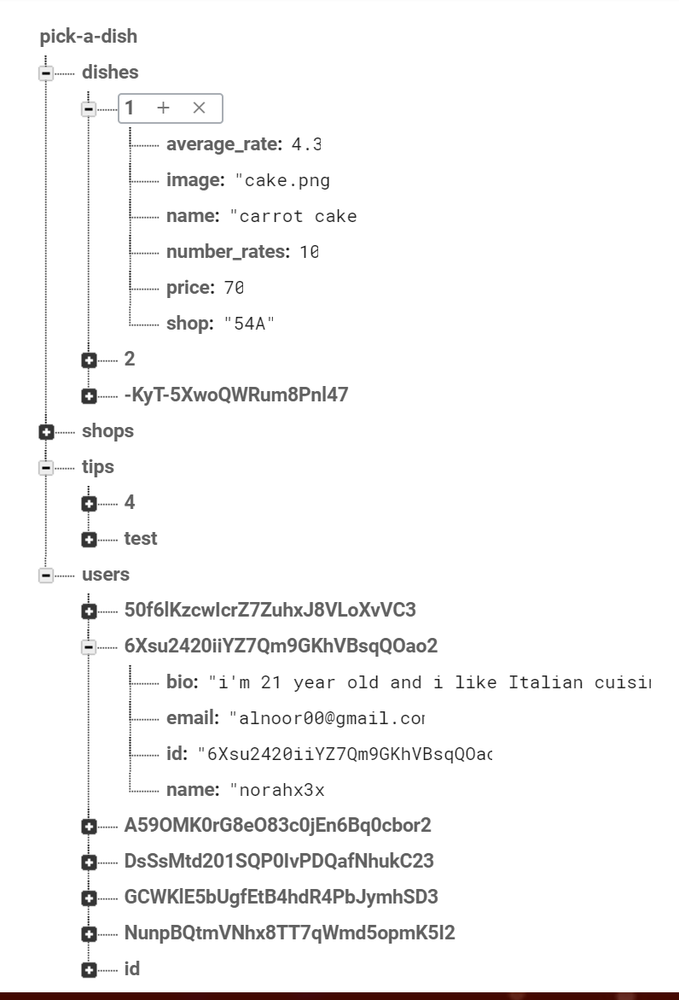
tools
We used firebase database as backend for our app “like”
We used ionic icons for app icons
We used colorlovers for color matching

Slide 5
Experience
Advantages:
Ionic View
Web Developers Can Be Mobile Developers (HTML, CSS, JS)
Disadvantages:
Command line
Few up to date tutorials

Slide 6
What we have done ?
Signup
login
Skip
List of dish (home page for all users)
Profile page
Settings page
Add new dish
dish page
Shops page
Shop page
List of user tips
List of user added dishes

Slide 7
demo

Slide 8
Thanks ☺
Pray for us

